Slide 1
Predicting Suicidal experiences among Youth experiencing homelessness (YEH): Striving for Stability, accuracy, and fairness
Anthony Fulginiti, PhD, MSW
Associate Professor, Graduate School of Social Work
University of Denver

Slide 2
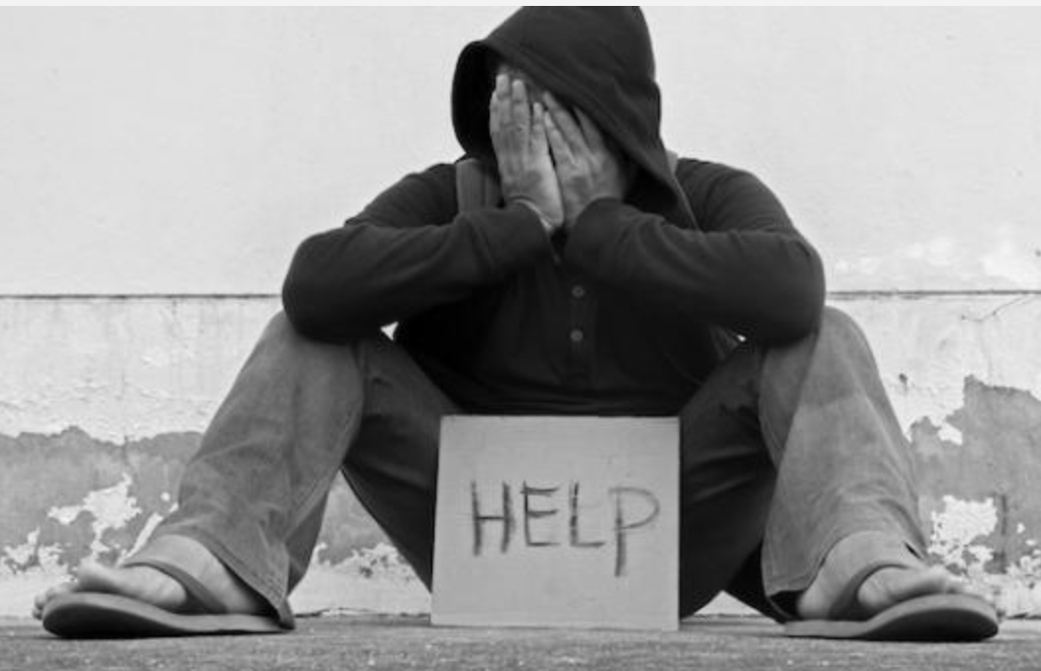
Homelessness & Suicidal Experiences
~4.2 million youth experience homelessness each year in the U.S.
Lifetime rates of suicidal ideation: ~40%
Lifetime rates of suicide attempts: ~35%
Past-year rates of suicidal ideation: ~30%
Past-year rates of suicide attempts: ~20%
http://www.nekys.org/homeless-youth/

Slide 3
Typical Suicidal Process
No
Suicidal Ideation
Suicidal Ideation
Suicide Attempt
Death by Suicide
Risk Prediction & Intervention Opportunities

Slide 4

Suicide prediction is hard!!!
https://www.inc.com/will-yakowicz/4-predictions-to-avoid-while-assessing-competitors.html

Slide 5

Person-centric view of suicide: Example Correlates of SI & SA
Age (Younger = higher risk)
Gender (Female = higher risk)
Depression
Substance Use
History of Trauma
Post-traumatic Stress

Slide 6

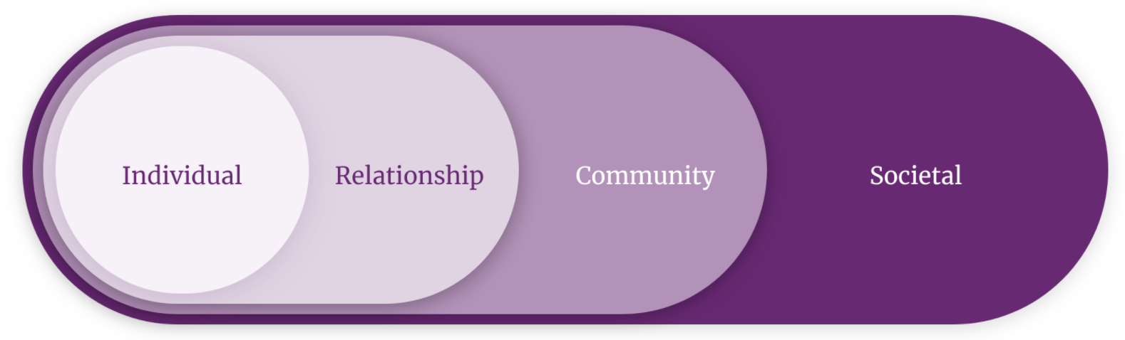


A Socioecological view of suicide: The environment matters
https://www.cdc.gov/violenceprevention/about/social-ecologicalmodel.html
https://college.harvard.edu/about/news-announcements/ai-can-help-reduce-risk-hiv-high-risk-communities

Slide 7
SOCIOECOLOGICAL VIEW OF SUICIDE: EXAMPLE CORRELATES OF SI & SA
Socioeconomic Disadvantage
Discrimination & Social Exclusion
Inadequate/Inaccessible Healthcare
Historical Trauma
Social support
Contagion
Relational Conflict/Victimization
Coping Norms
RELATIONSHIP FACTORS
COMMUNITY/SOCIETAL FACTORS

Slide 8

Suicide among Youth experiencing homelessness is a social justice issue
Suicide-Related Disparities Among YEH
Suicide-Related Disparities Among Youth with Minoritized Identities (e.g., gender and sexual minorities)
Youth with Minoritized Identities (e.g., racial/ethnic, gender, and sexual minorities) are overrepresented among YEH

Slide 9
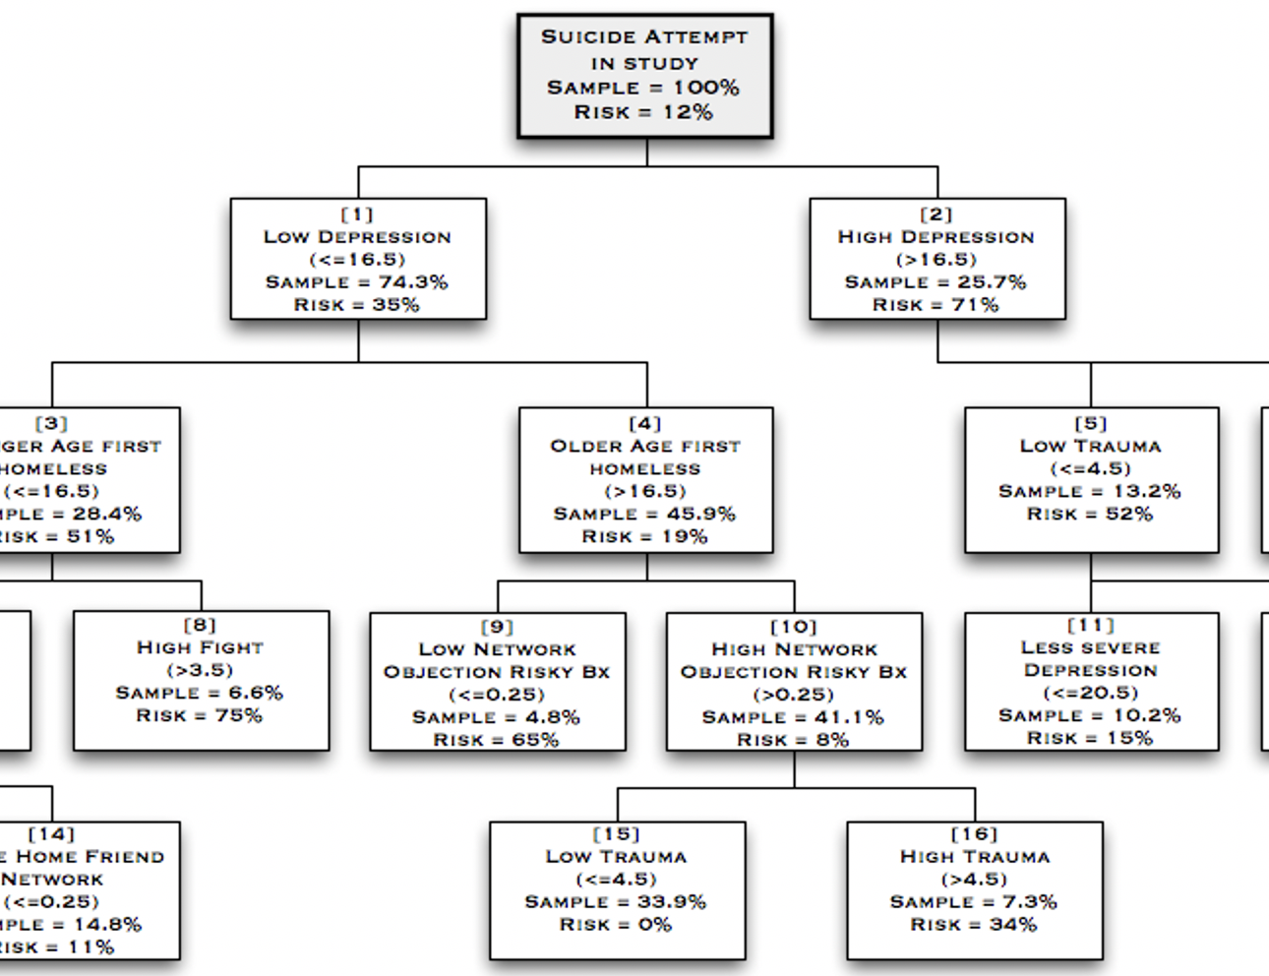
Efforts to improve predictions: Iteration 1
We included both personal and social environment characteristics into our prediction models
We used decision tree analyses (specifically CART models) to account for complex interactions and produce results that are more interpretable to guide service delivery

Slide 10
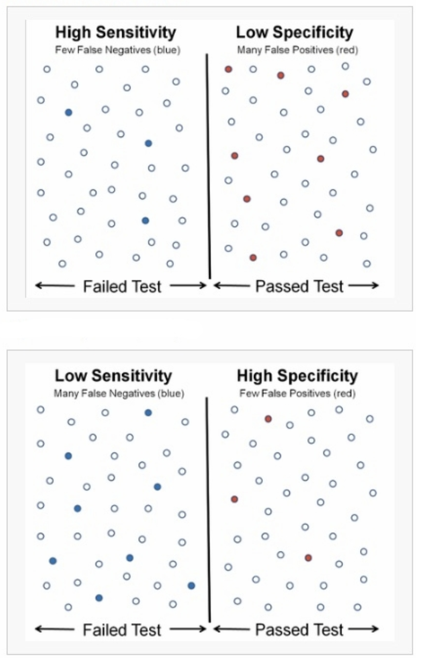
What were the results of our DT models?
Suicidal Ideation
AUC: .79
Sensitivity: 48%
Specificity: 73%
Suicide Attempts
AUC: .86
Sensitivity: 68%
Specificity: 72%
Literature Comparison
Median/Mean AUC = .76/.78

Slide 11

Iteration 1: limitations
We used a train-split approach: a single split was used to create the training and testing datasets (80:20) for our decision-tree models. This raised questions about the robustness of the model performance.
The majority of youth did not have suicidal experiences, but we did not account for class imbalance issues when making predictions.
We did not test whether predictions were fair across different gender, sexual orientation, and racial/ethnic groups.
https://portlandenglish.edu/pela-blog/have-or-be/question-mark-1421013_1280/

Slide 12
Iteration 2: Summary & Challenges
This problem was presented in this class several years ago and efforts were made to address the limitations of iteration 1.
Although k-fold cross validation was used to better evaluate the robustness of the overall model performance, the individual surrogate models were substantially different from one another (e.g., different constituent features).
Although it is common to have different feature/variable sets across individual trees when using ensemble methods (e.g., random forests), such differences can make it more challenging to interpret the results for applied purposes (e.g., treatment/program planning)
Is it possible to develop a model that can produce more interpretable results (i.e., stability of features across individual trees) while also delivering accurate and fair predictions?
https://portlandenglish.edu/pela-blog/have-or-be/question-mark-1421013_1280/

Slide 13

Overarching Project Aims
Increase the stability of feature/variable sets across individual surrogate trees
Increase the accuracy of our predictions related to suicidal experiences (e.g., sensitivity/specificity)
Improve the fairness of our predictions related to suicidal experiences across gender, sexual orientation, and racial/ethnic identities
https://www.searchenginejournal.com/seo-goals/285965/#close https://www.searchenginejournal.com/seo-goals/285965/#close

Slide 14

Implications of the Project
Decision trees that produce accurate suicide-related predictions can lead to more effective suicide risk management
Although ensemble methods are generally preferred to improve predictions, such methods can introduce challenges for interpretability. Finding a way to improve prediction accuracy while maintaining interpretability may help to inform suicide prevention programming, resource allocation, and perhaps even aid theory development
Striving for fairness in our decision tree predictions is a social justice action that ensures we are not compounding the suicidogenic effects of inequity.
https://www.nuveen.com/en-us/insights/fixed-income-impact-investing/impact-framework-methodology

Slide 15

Description of the Project dataset
Sample size = 940
Data were collected as part of project designed to understand HIV/AIDS risk-taking behavior among young people experiencing homelessness.
Data collection occurred between October 2011 and February 2013
Recruited from two drop-in centers that serve young people experiencing homelessness in Hollywood and Santa Monica, CA.
Survey + Social Network Interview
https://www.linkedin.com/pulse/seven-key-characteristics-project-stanley-epstein/

Slide 16
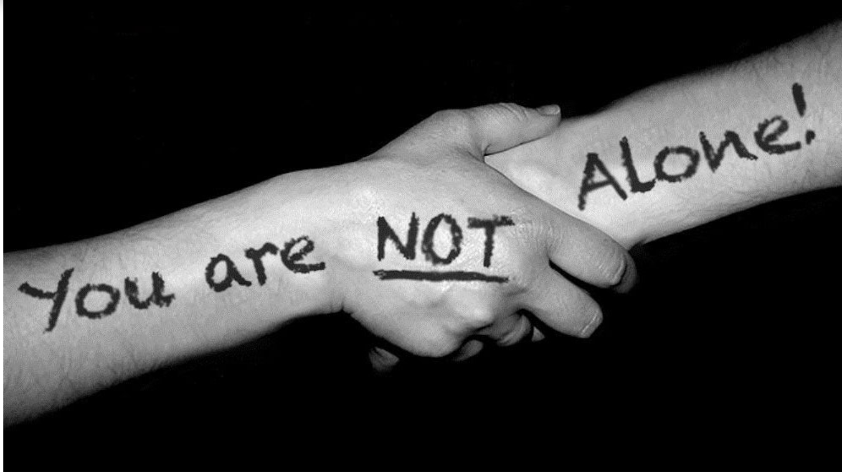
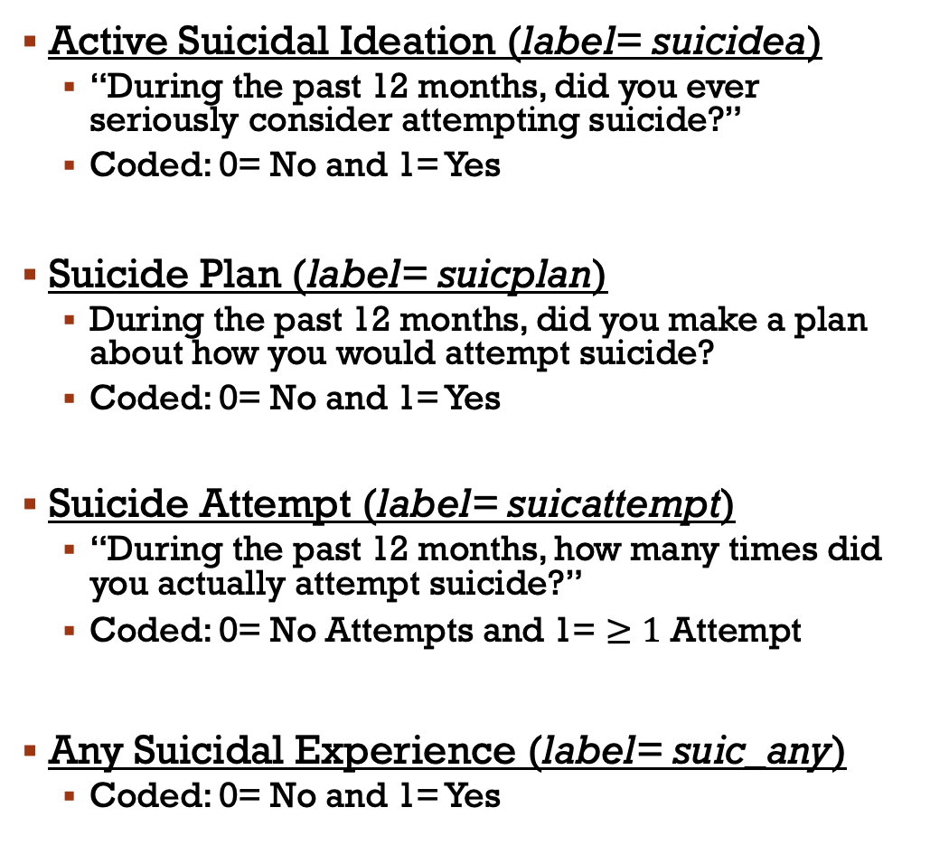
Prospective Dependent Variables
Active Suicidal Ideation (label= suicidea)
“During the past 12 months, did you ever seriously consider attempting suicide?”
Coded: 0= No and 1= Yes
Suicide Plan (label= suicplan)
During the past 12 months, did you make a plan about how you would attempt suicide?
Coded: 0= No and 1= Yes
Suicide Attempt (label= suicattempt)
“During the past 12 months, how many times did you actually attempt suicide?”
Coded: 0= No Attempts and 1= $≥1$ Attempt
Any Suicidal Experience (label= suic_any)
Coded: 0= No and 1= Yes
https://www.bhsarkansas.org/about/news-events/national-suicide-prevention-month

Slide 17
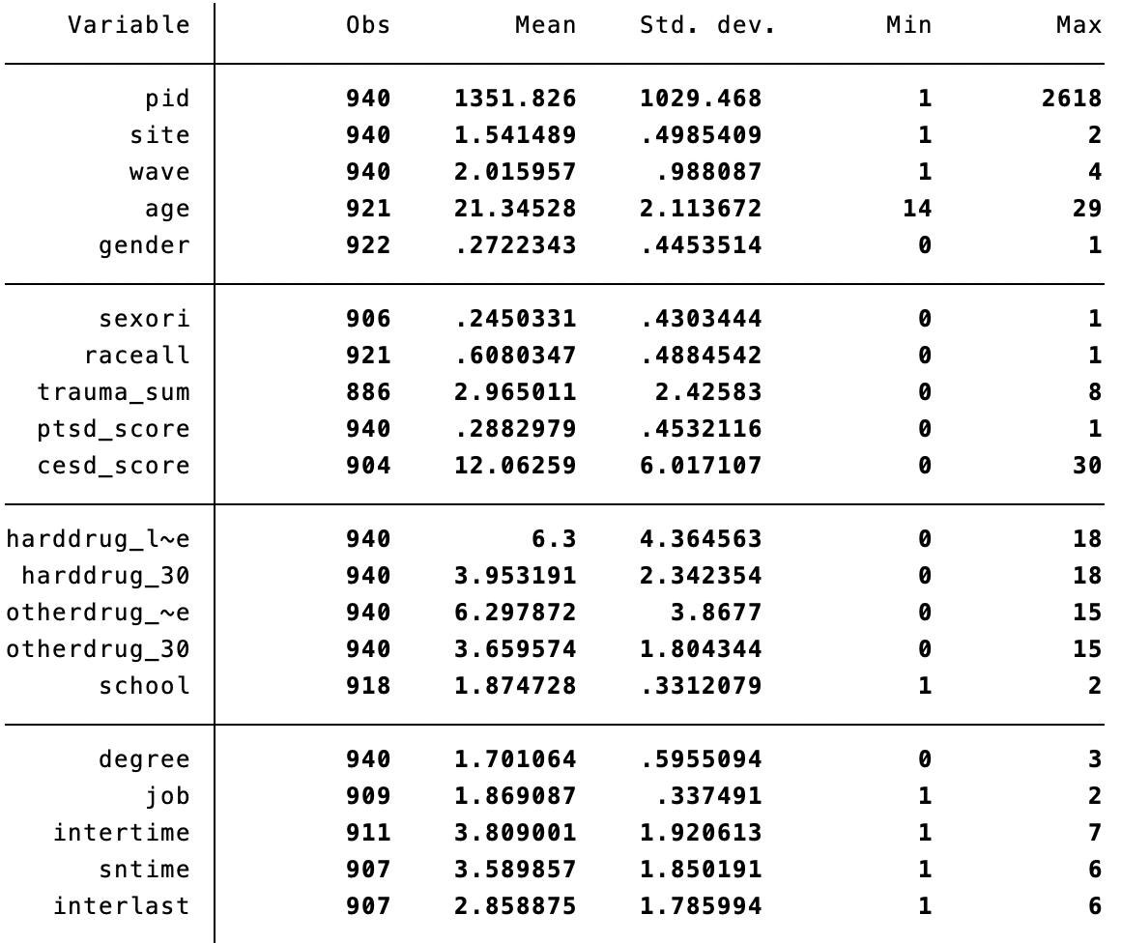
InDependent Variables: Personal Characteristics
47 variables that assess personal attributes
Sociodemographic factors (e.g. education)
Mental health factors (e.g., depression, trauma)
Substance use (e.g., alcohol, marijuana, hard drug use),
Sexual risk behaviors (e.g., # sex partners),
Violence perpetration and victimization (e.g., weapon-carrying, IPV victim),
Justice system involvement (e.g., spending time in jail; Harris et al., 2009),
Online activity (e.g., time spent online)
Homelessness indices (e.g., time spent homeless; age first homeless).

Slide 18
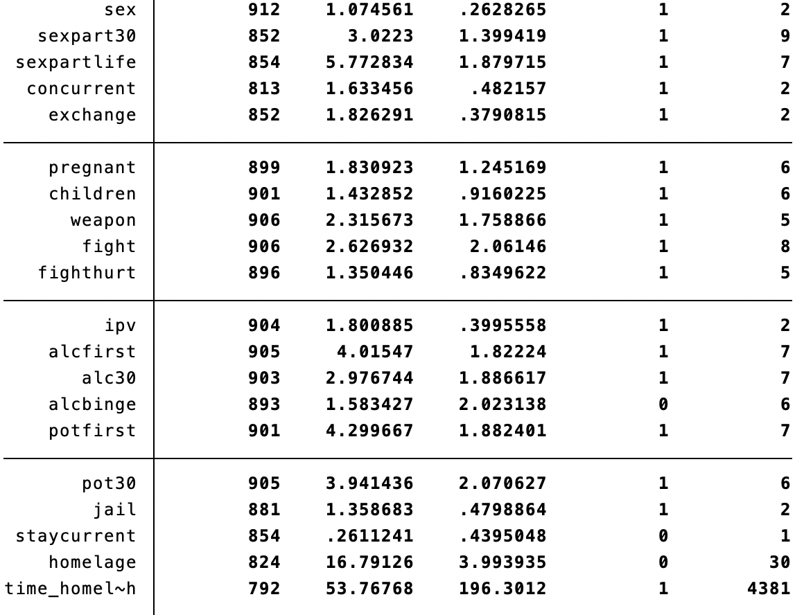
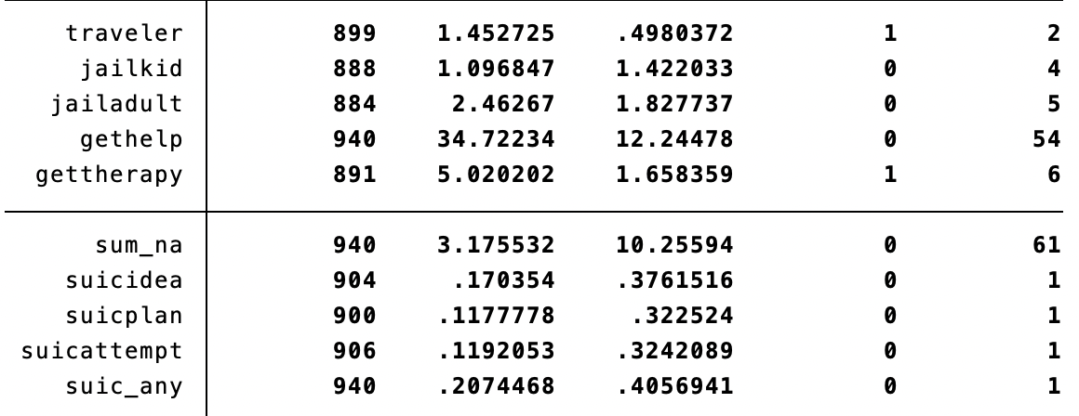
InDependent Variables: Personal Characteristics

Slide 19
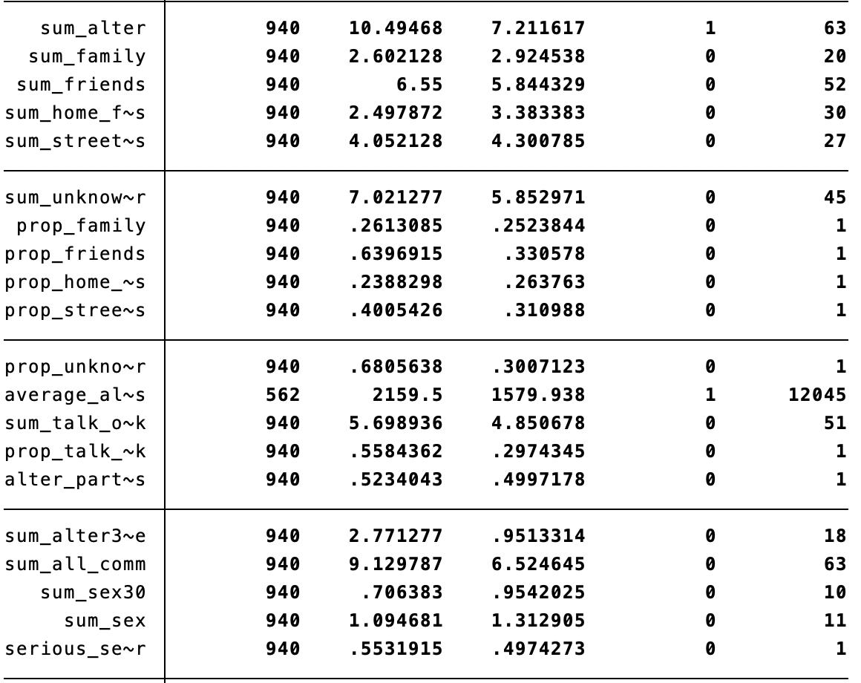

InDependent Variables:
Social Network Characteristics
74 variables that assess social network attributes
Two types of variables---proportion and sum scores---were derived for each network attribute (i.e., 37 unique network attributes measured in two different ways)
Relationship types (i.e., family, friends, intimate partners, home-based peers, street-based peers)
Frequency of contact
Substance use behavior (e.g., hard drug use)
Sexual risk behavior (e.g., unprotected sex)
Social support provision (e.g., emotional or tangible support)
Encouragement/rejection of risky behavior

Slide 20
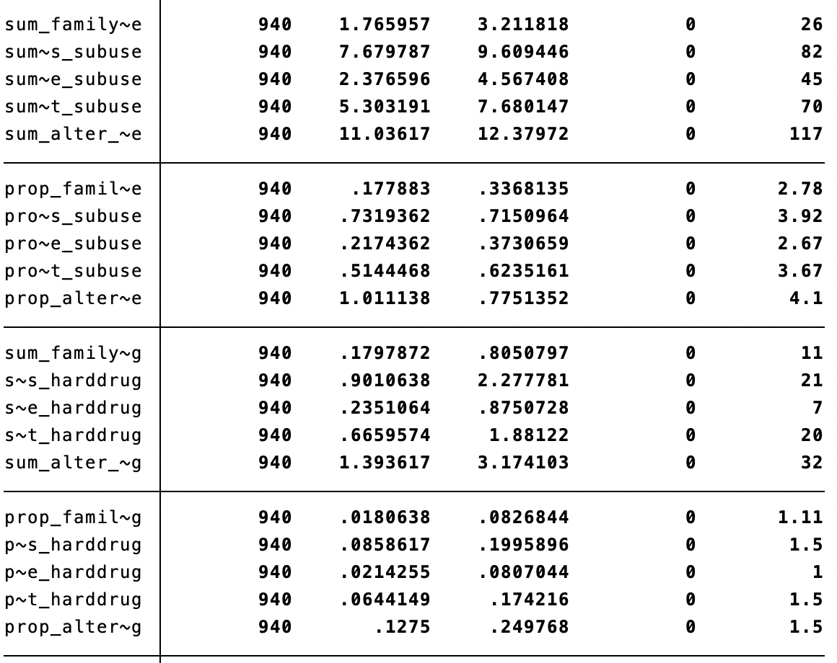
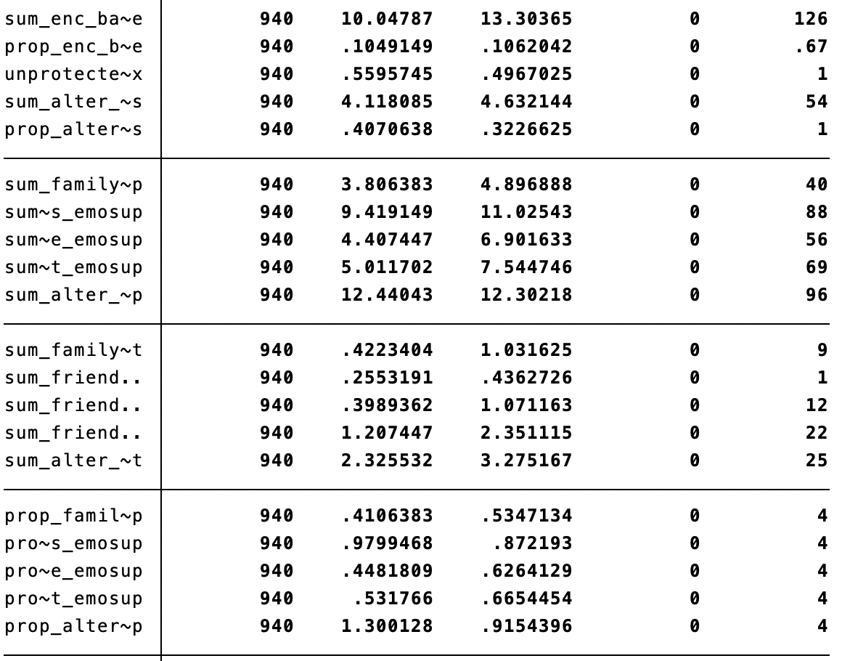
InDependent Variables:
Social Network Characteristics

Slide 21

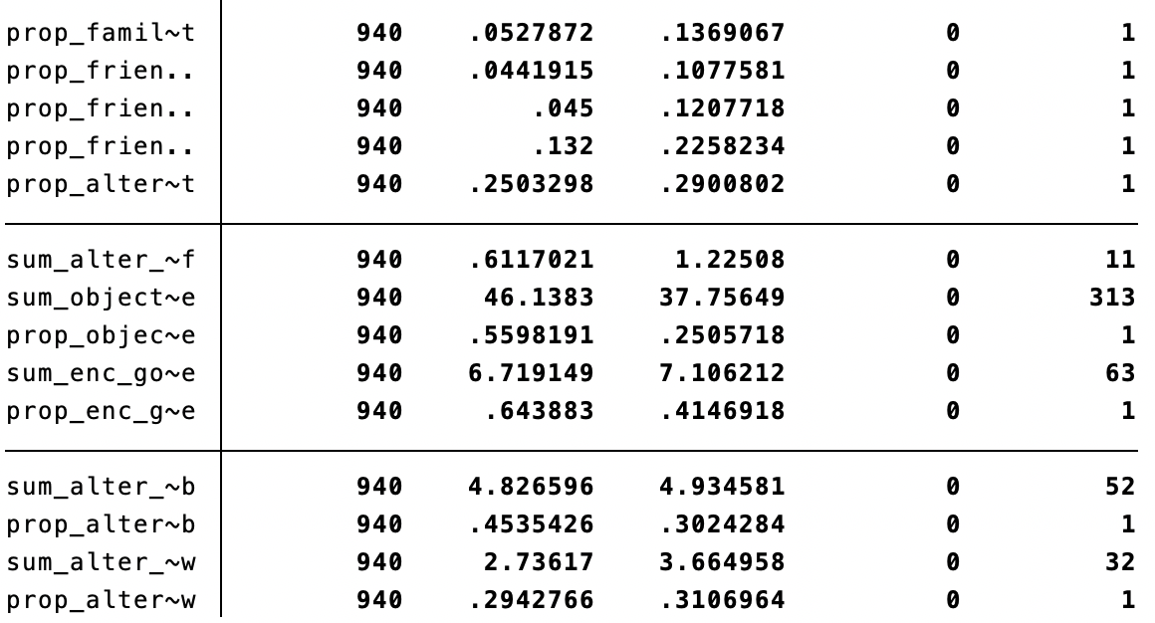
InDependent Variables:
Social Network Characteristics
https://www.digitaltrends.com/features/the-history-of-social-networking/

Slide 22

Prospective Fairness Variables
Gender Identity
Male (coded 1)
Female (coded 2)
Transgender Female (coded 3)
Transgender Male (coded 4)
Sexual Orientation Identity
Gay or Lesbian (coded 1)
Queer (coded 2)
Bisexual (coded 3)
Heterosexual (coded 4)
Questioning/Unsure (coded 5)
Race/Ethnic Group Identity
American Indian or Alaska Native (coded 1)
Asian (coded 2)
Black or African American (coded 3)
Native Hawaiian or Other Pacific Islander (coded 4)
White (coded 5)
Latino/Hispanic (coded 6)
Mixed race (coded 7)
*May need to combine categories to achieve adequate subgroup representation for analysis

Slide 23
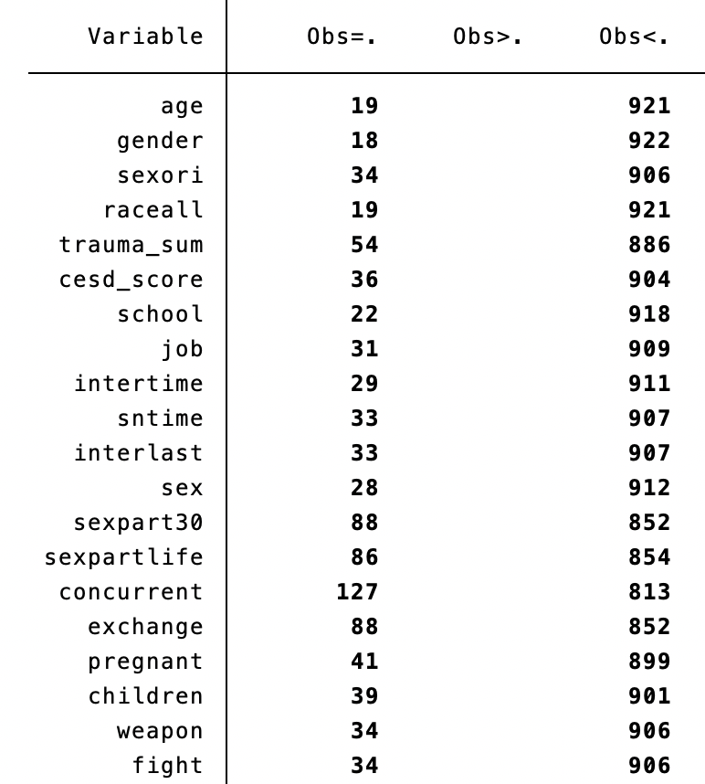
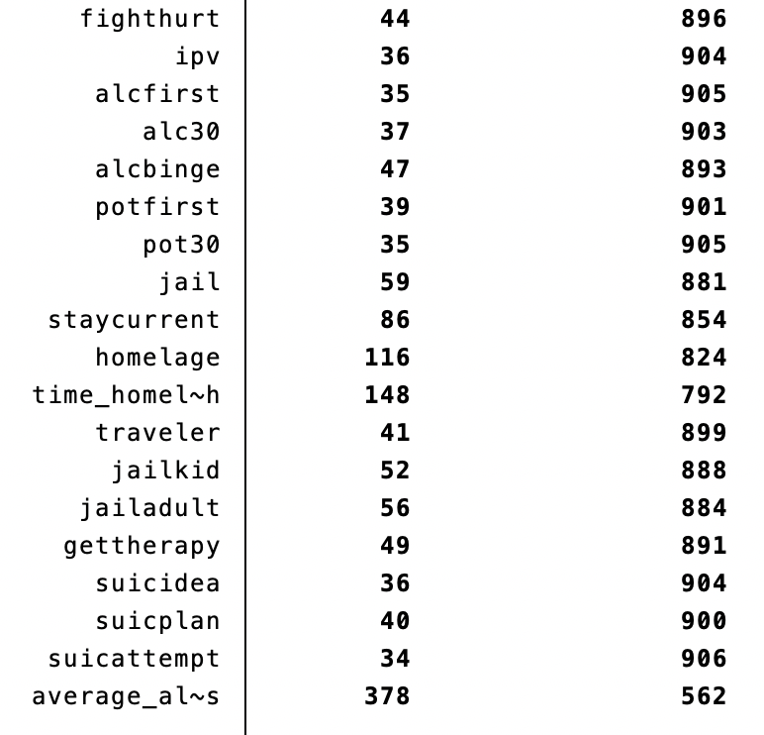
Missing Data
Notes:
Missing data on 39 variables

Slide 24

Questions…I can’t guarantee answers!
https://www.fluentu.com/blog/chinese/chinese-question-words/

Slide 25


Suicide prevention is everyone’s business!
National Suicide Prevention Lifeline: 800-273-8255

